Slide 1
Recap Definition of TG continued …
Definition: A Transition graph (TG), is a collection of the followings
  Finite number of states, at least one of which is start state and some (maybe none) final states.
  Finite set of input letters (Σ) from which input strings are formed.
  Finite set of transitions that show how to go from one state to another based on reading specified substrings of input letters, possibly even the null string (Λ).

Slide 2
Note
It is to be noted that in TG there may exist more than one paths for certain string, while there may not exist any path for certain string as well. If there exists at least one path for a certain string, starting from initial state and ending in a final state, the string is supposed to be accepted by the TG, otherwise the string is supposed to be rejected. Obviously collection of accepted strings is the language accepted by the TG.

Slide 3
Example
Consider the Language L , defined over Σ = {a, b} of all strings including Λ. The language L may be accepted by the following TG
The language L may also be accepted by the following TG
a,b
a,b
-
Λ
+

Slide 4
Example Continued …
TG₁
TG₂
a,b
±
a,b
±
a,b
+

Slide 5
Example
Consider the following TGs
-
TG₁
-
a,b
1
TG₂
a,b
-
a,b
1
TG₃

Slide 6
Example Continued …
It may be observed that in the first TG, no transition has been shown. Hence this TG does not accept any string, defined over any alphabet. In TG₂ there are transitions for a and b at initial state but there is no transition at state 1. This TG still does not accept any string. In TG₃ there are transitions at both initial state and state 1, but it does not accept any string.

Slide 7
Example Continued …
Thus none of TG₁, TG₂ and TG₃ accepts any string, i.e. these TGs accept empty language. It may be noted that TG₁ and TG₂ are TGs but not FA, while TG₃ is both TG and FA as well.
It may be noted that every FA is a TG as well, but the converse may not be true, i.e. every TG may not be an FA.

Slide 8
Example
Consider the language L of strings, defined over Σ={a, b}, starting with b. The language L may be expressed by RE b(a + b)* , may be accepted by the following TG
a,b
––
b
+

Slide 9
Example
Consider the language L of strings, defined over Σ={a, b}, not ending in b. The language L may be expressed by RE Λ + (a + b)*a , may be accepted by the following TG
a,b
1
––
a
2+
Λ
3––
4+
––

Slide 10
TASK
Build a TG accepting the language of strings, defined over Σ={a, b}, ending in b.

Slide 11
Example
Consider the Language L of strings, defined over Σ = {a, b}, containing double a.
The language L may be expressed by the following regular expression
(a+b)* (aa) (a+b)*. This language may be accepted by the following TG

Slide 12
Example Continued …
b,a
b,a
aa
1-
2+

Slide 13
Example
Consider the language L of strings, defined over Σ={a, b}, having double a or double b.
The language L can be expressed by RE
(a+b)* (aa + bb) (a+b)*.
The above language may also be expressed by the following TGs.

Slide 14
Example continued …
x
a
a
a,b
a,b
––
+
b
b
y

Slide 15
OR
a,b
a,b
-
aa,bb
+

Slide 16
OR
a,b
a,b
aa
1-
2+
a,b
a,b
bb
3-
4+

Slide 17
Note
In the above TG if the states are not labeled then it may not be considered to be a single TG

Slide 18
Task Solution
Build a TG accepting the language L of strings, defined over Σ={a, b}, ending in b.
Solution The language L may be expressed by RE (a + b)*b, may be accepted by the following TG
a,b
––
b
+

Slide 19
Example
Consider the language L of strings, defined over Σ={a, b}, having triple a or triple b. The language L may be expressed by RE
(a+b)* (aaa + bbb) (a+b)*
This language may be accepted by the following TG

Slide 20
Example Continued …
2
a
4
a
a
a,b
a,b
1–
6+
b
b
3
b
5

Slide 21
OR
a,b
a,b
-
aaa,bbb
+

Slide 22
OR
a,b
a,b
1-
aaa
2+
a,b
a,b
3-
bbb
4+

Slide 23
Example
Consider the language L of strings, defined over Σ = {a, b}, beginning and ending in different letters.
The language L may be expressed by RE
a(a + b)*b + b(a + b)*a
The language L may be accepted by the following TG

Slide 24
Example continued …
a, b
b
4+
2
a
1-
a,b
b
3
a
5+

Slide 25
Example
Consider the Language L of strings of length two or more, defined over Σ = {a, b}, beginning with and ending in same letters.
The language L may be expressed by the following regular expression
a(a + b)*a + b(a + b)*b
This language may be accepted by the following TG

Slide 26
Example Continued …
a, b
a
4+
2
a
1-
a,b
b
b
3
5+

Slide 27
Example
Consider the language L, defined over Σ={a, b}, in which a’s occur only in even clumps and that ends in three or more b’s. The language L can be expressed by its regular expression
(aa)*b(b*+(aa(aa)*b)*) bb
OR
(aa)*b(b*+( (aa)⁺b)*) bb
The language L may be accepted by the following TG

Slide 28
Example Continued …
aa
b
b
b
2
b
+
-
1
aa

Slide 29
Example
Consider the EVEN-EVEN language, defined over Σ={a, b}. As discussed earlier that EVEN-EVEN language can be expressed by a regular expression (aa+bb+(ab+ba)(aa+bb)*(ab+ba))*
The language EVEN-EVEN may be accepted by the following TG

Slide 30
Example continued …
aa,bb
aa,bb
ab,ba
1±
2
ab,ba

Slide 31
Recap lecture 9
TGs accepting the languages:containing aaa or bbb, beginning and ending in different letters, beginning and ending in same letters, EVEN-EVEN, a’s occur in even clumps and ends in three or more b’s, example showing different paths traced by one string, Definition of GTG

Slide 32
Task Solution …
Build a TG accepting the language L of strings, defined over Σ={a, b}, beginning with and ending in the same letters
Solution:The language L may be expressed by
a+b+a(a + b)*a + b(a + b)*b
The language L may be accepted by the following TG

Slide 33
Task Solution
.b
a
a
b
b
4+
a
3+
2-
1-
b
a
b
a
5
a
6
b

Slide 34
Generalized Transition Graphs
A generalized transition graph (GTG) is a collection of three things
  Finite number of states, at least one of which is start state and some (maybe none) final states.
  Finite set of input letters (Σ) from which input strings are formed.
  Directed edges connecting some pair of states labeled with regular expression.
  It may be noted that in GTG, the labels of transition edges are corresponding regular expressions

Slide 35
Example
Consider the language L of strings, defined over Σ={a,b}, containing double a or double b. The language L can be expressed by the following regular expression
(a+b)* (aa + bb) (a+b)*
The language L may be accepted by the following GTG.

Slide 36
Example continued …
a+b
a+b
-
aa+bb
+

Slide 37
Example
Consider the Language L of strings, defined over Σ = {a, b}, beginning with and ending in same letters.
The language L may be expressed by the following regular expression
(a+b)+ a(a + b)*a + b(a + b)*b
This language may be accepted by the following GTG

Slide 38
Example
a⁺
b⁺
+
+
a⁺
b⁺
–
b⁺
b⁺
a⁺
+
+
a⁺

Slide 39
Example
Consider the language L of strings of, defined over Σ = {a, b}, beginning and ending in different letters.
The language L may be expressed by RE
a(a + b)*b + b(a + b)*a
The language L may be accepted by the following GTG

Slide 40
Example Continued …
+
b(a+b)*a
-
a( a+b)* b
+
The language L may be accepted by the following GTG as well

Slide 41
Example Continued …
-
b(a+b)*a + a( a+b)* b
+

Slide 42
Example
Consider the language L of strings, defined over Σ={a, b}, having triple a or triple b. The language L may be expressed by RE
(a+b)* (aaa + bbb) (a+b)*
This language may be accepted by the following GTG

Slide 43
Example Continued …
a+b
a+b
-
aaa+bbb
+
OR
(a+b)*(aaa+bbb)(a+b)*
-
+

Slide 44
Nondeterminism
TGs and GTGs provide certain relaxations i.e. there may exist more than one path for a certain string or there may not be any path for a certain string, this property creates nondeterminism and it can also help in differentiating TGs or GTGs from FAs. Hence an FA is also called a Deterministic Finite Automaton (DFA).

Slide 45
Kleene’s Theorem
If a language can be expressed by
FA or
TG or
RE
then it can also be expressed by other two as well.
It may be noted that the theorem is proved, proving the following three parts

Slide 46
Kleene’s Theorem continued …
Kleene’s Theorem Part I
If a language can be accepted by an FA then it can be accepted by a TG as well.
Kleene’s Theorem Part II
If a language can be accepted by a TG then it can be expressed by an RE as well.
Kleene’s Theorem Part III
If a language can be expressed by a RE then it can be accepted by an FA as well.

Slide 47
Kleene’s Theorem continued …
Proof(Kleene’s Theorem Part I)
Since every FA can be considered to be a TG as well, therefore there is nothing to prove.

Slide 48
Kleene’s Theorem continued …
Proof(Kleene’s Theorem Part II)
To prove part II of the theorem, an algorithm consisting of different steps, is explained showing how a RE can be obtained corresponding to the given TG. For this purpose the notion of TG is changed to that of GTG i.e. the labels of transitions are corresponding REs.

Slide 49
Kleene’s Theorem part II continued …
Basically this algorithm converts the given TG to GTG with one initial state along with a single loop, or one initial state connected with one final state by a single transition edge. The label of the loop or the transition edge will be the required RE.
Step 1 If a TG has more than one start states, then introduce a new start state connecting the new state to the old start states by the transitions labeled by Λ and make the old start states the non-start states. This step can be shown by the following example

Slide 50
Example
b
b
1-
3+
aa
a
a
2-
4+
bb

Slide 51
Example Continued ...
b
b
1
3+
Λ
aa
-
a
Λ
a
2
4+
bb

Slide 52
Kleene’s Theorem part II continued …
Step 2:
If a TG has more than one final states, then introduce a new final state, connecting the old final states to the new final state by the transitions labeled by Λ.
This step can be shown by the previous example of TG, where the step 1 has already been processed

Slide 53
Example
b
b
1
3+
Λ
aa
-
a
Λ
a
2
4+
bb

Slide 54
Example continued …
b
b
1
3
Λ
aa
Λ
-
a
Λ
a
+
Λ
2
4
bb

Slide 55
Kleene’s Theorem part II continued …
Step 3:
If a state has two (more than one) incoming transition edges labeled by the corresponding REs, from the same state (including the possibility of loops at a state), then replace all these transition edges with a single transition edge labeled by the sum of corresponding REs.
This step can be shown by a part of TG in the following example

Slide 56
Example
r₃
The above TG can be reduced to
r₁
….
5
4
….
r₂
r₄
r₃+r₄
r₁+r₂
….
5
4
….

Slide 57
Note
The step 3 can be generalized to any finite number of transitions as shown below
The above TG can be reduced to
r₁
r₂
….
5
….
….
r_{n}
…
r₁+r₂ + +r_{n}
….
5
….

Slide 58
Kleene’s Theorem part II continued …
Step 4 (bypass and state elimination)
If three states in a TG, are connected in sequence then eliminate the middle state and connect the first state with the third by a single transition (include the possibility of circuit as well) labeled by the RE which is the concatenation of corresponding two REs in the existing sequence. This step can be shown by a part of TG in the following example

Slide 59
Example
r₃
r₂
r₄
….
4
5
6
….
To eliminate state 5 the above can be reduced to
r₂r₃*r₄
….
….
4
6
Consider the following example containing a circuit

Slide 60
Example
Consider the part of a TG, containing a circuit at a state, as shown below
To eliminate state 3 the above TG can be reduced to
r₂
r₃
r₁
3
4
….
….
2
r₄
r₄r₂*r₃
r₁r₂*r₃
….
….
2
4

Slide 61
Example
Consider a part of the following TG
To eliminate state 3 the above TG can be reduced to
r₂
r₁
r₃
r₇
r₉
r₅
….
2
3
4
….
r₄
r₈
r₆

Slide 62
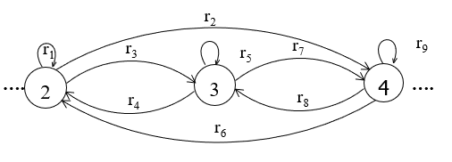
Example continued ...
To eliminate state 4 the above TG can be reduced to
r₁ +r₃ r₅* r₄
r₉ + r₈r₅*r₇
r₂ +r₃ r₅* r₇
….
2
4
….
r₆ + r₈r₅*r₄
(r₁ +r₃ r₅* r₄ )+(r₂ +r₃ r₅* r₇ )(r₉ +r₈ r₅* r₇ )*(r₆ +r₈ r₅* r₄ )
….
2
….

Slide 63
Note
It is to be noted that to determine the RE corresponding to a certain TG, four steps have been discussed. This process can be explained by the following particular examples of TGs

Slide 64
Example
Consider the following TG
To have single final state, the above TG can be reduced to the following
aa,b
2+
aaa
-
ab,ba
1
bba
3+

Slide 65
Example continued …
aa+b
To eliminate states 2 and 3, the above TG can be reduced to the following
The above TG can be reduced to the following
2
aaa
Λ
-
ab+ba
1
4+
bba
Λ
3
aa+b
-
ab+ba
aaa Λ+bbaΛ
1
4+

Slide 66
Example continued …
To eliminate state 1 the above TG can be reduced to the following
Hence the required RE is (ab+ba)(aa+b)*(aaa+bba)
-
(ab+ba)(aa+b)*(aaa+bba)
+

Slide 67
Summing Up
Definition of GTG, examples of GTG accepting the languages of strings:containing aa or bb, beginning with and ending in same letters, beginning with and ending in different letters, containing aaa or bbb,
Nondeterminism, Kleene’s theorem (part I, part II, part III), proof of Kleene’s theorem part I

Slide 68
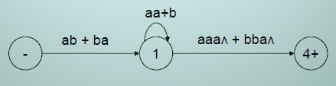

Kleene’s Theorem
  To eliminate state 2 and 3, the above TG cab be reduced to
  To eliminate state 1 the above TG can be reduced to
  Hence the required RE is (ab + ba) (aa+b)* (aaa+bba)

Slide 69
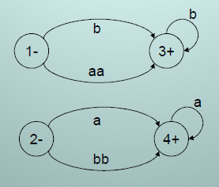
Kleene’s Theorem
Example:
  To have single initial and single final state the above TG can be reduced to the following

Slide 70
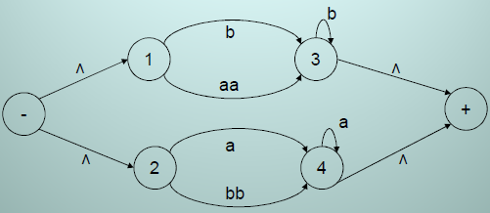
Kleene’s Theorem
  To obtain single transition edge between 1 and 3; 2 and 4, the above TG can be reduced to the following

Slide 71
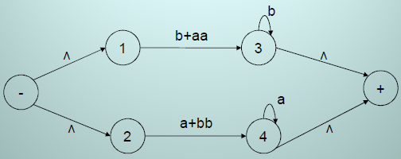
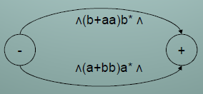
Kleene’s Theorem
  To obtain single transition edge between 1 and 3; 2 and 4, the above TG can be reduced to the following

Slide 72

Kleene’s Theorem
  To connect the initial state with the final state by single transition edge, the above TG can be reduced to the following
  Hence the required RE is (b+aa)b* +(a+bb)a*

Slide 73
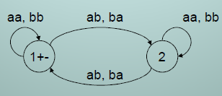
Kleene’s Theorem
Example:
  Consider the following TG accepting Even-Even Language
  To have single initial and single final state the above TG can be reduced to the following

Slide 74
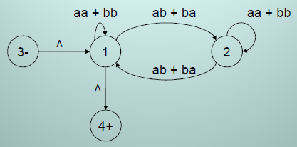
Kleene’s Theorem
  To eliminate state 2 the above TG can be reduced to the following

Slide 75
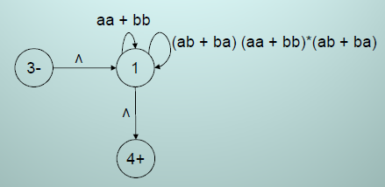
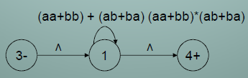
Kleene’s Theorem
  To have single loop at state 1 the above TG can be reduced to the following

Slide 76

Kleene’s Theorem
  To eliminate state 1 the above TG can be reduced to the following
  Hence the required RE is ((aa+bb) + (ab, ba) (aa, bb)*(ab, ba))*

Slide 77
Summing Up
proof of Kleene’s theorem part II (method with different steps), particular examples of TGs to determine corresponding Res.

Slide 78
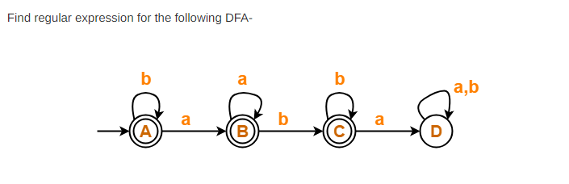

Slide 79
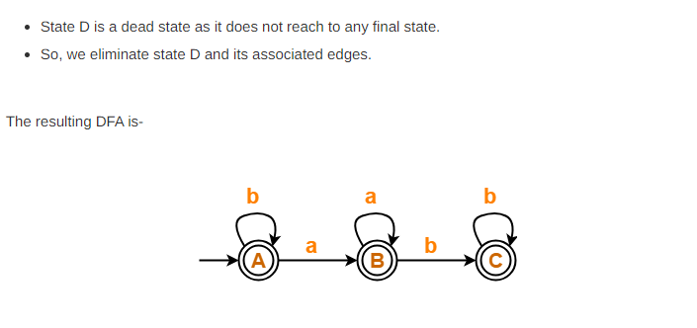

Slide 80
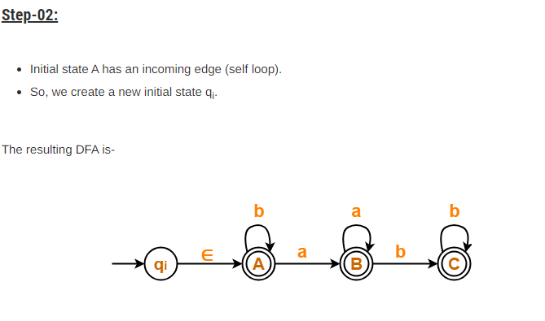

Slide 81
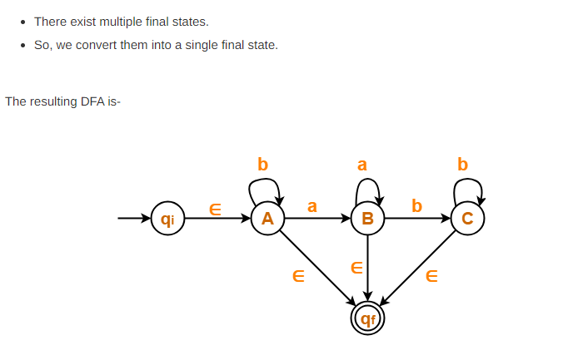

Slide 82
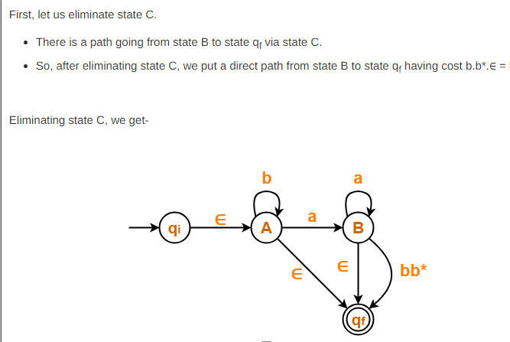

Slide 83
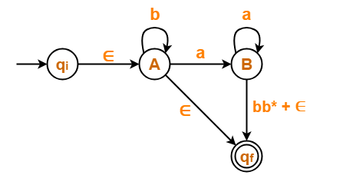

Slide 84
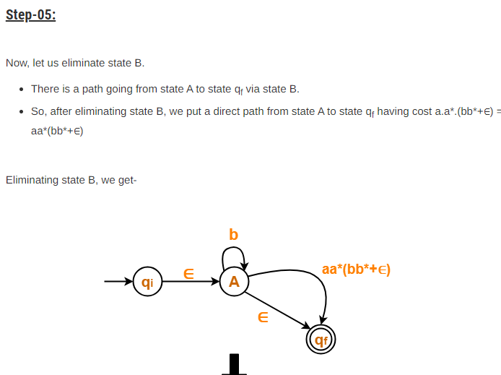

Slide 85
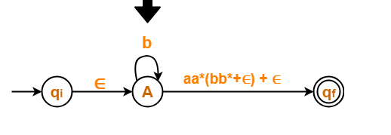

Slide 86
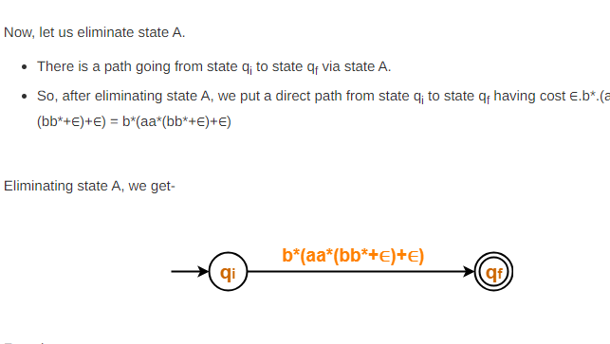


Slide 87
Summing Up
proof of Kleene’s theorem part II (method with different steps), particular examples of TGs to determine corresponding Res.

